Slide 1

DISPARITIES IN VICTIMIZATION RATES AMONG ASIAN BLACK & WHITE AMERICANS FROM 2020-2021
EPPS 6356 Data Visualization
Farrah Ali, Hoda Elsafadi, Grant Powell, Tayaba Saleem, Yichao Jin
Fall 2023

Slide 2
TABLE OF CONTENTS
1
TOPIC OVERVIEW
5
RESULTS
2
LITERATURE REVIEW
6
SHINY APP DEMO
3
HYPOTHESES
7
CONCLUSION
4
METHODOLOGY
8
WORKS CITED

Slide 3

TOPIC OVERVIEW
DISPARITIES IN VICTIMIZATION RATES AMONG ASIAN, BLACK AND WHITE IN THE CITY OF LOS ANGELES FROM 2020-2021
The objective of our research is to graphically demonstrate the disparities, if any, in victimization rates of Asian and Black Americans as compared to White people in the city of Los Angeles from 2020-2022. This will allow us to understand the impact of the COVID pandemic as well as political and social shifts on victimization rates among these groups.

Slide 4

LITERATURE REVIEW
Victimization of Asian Americans
There was a reported increase in hate crimes against Asian-Americans and people of Asian descent during the t COVID pandemic. Researchers such as Smith (2020) noted a surge in incidents like verbal harassment, physical assaults, and vandalism specifically directed at individuals of Asian descent.
.

Slide 5

LITERATURE REVIEW
Victimization of Black Americans
African Americans have been disproportionately affected by hate crimes, a consequence of systemic racism and historical injustices (Smith, 2020). Racial profiling, economic disparities, and a legacy of historical injustices contribute to an environment where hate crimes against this community persist.

Slide 6

HYPOTHESIS
Ha #1: Over time we will see the disparity in victimization rates increase between Asian Americans and White people in Los Angeles from 2020-2021.
Ha #2: Over time we will see the disparity in victimization rates increase between Black people and White people in Los Angeles from 2020-2021.

Slide 7

METHODOLOGY
We will be utilizing secondary data on crime in Los Angeles from 2020 to 2021 from Data.gov. We will assess the relationship between race and victimization rates throughout the COVID pandemic and civil unrest that occurred in 2020.
Our visualization techniques will include bar charts, pie charts, scatterplots, and a time series discontinuity design to appropriately depict our analysis and findings.

Slide 8
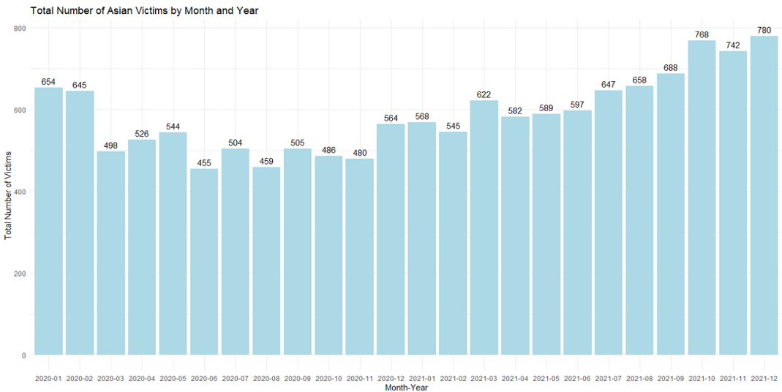
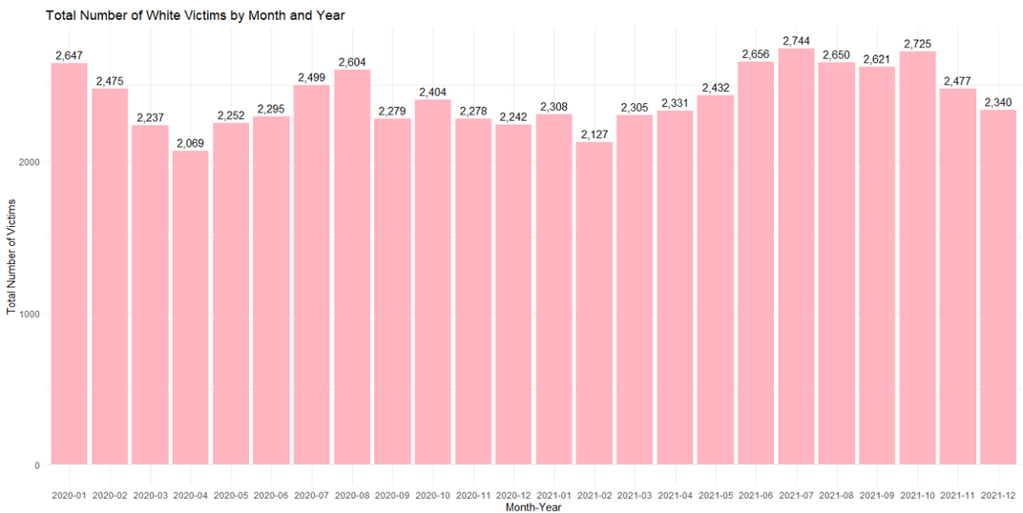
RESULTS
COMPARISON BETWEEN VICTIMIZATION RATES OF ASIAN & WHITE AMERICANS FROM 2020-2021: MONTHLY
ASIAN
WHITE

Slide 9
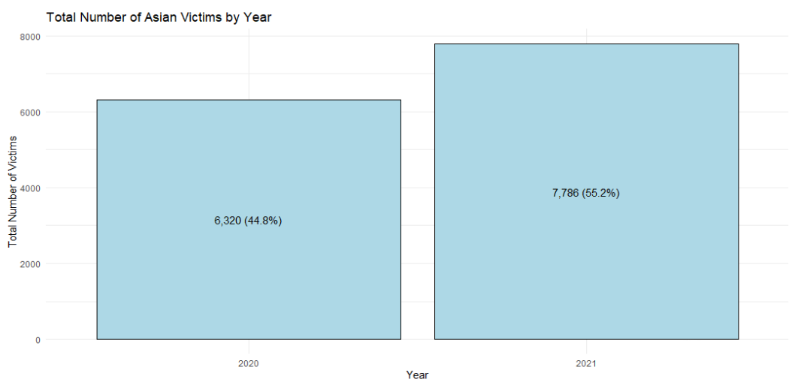
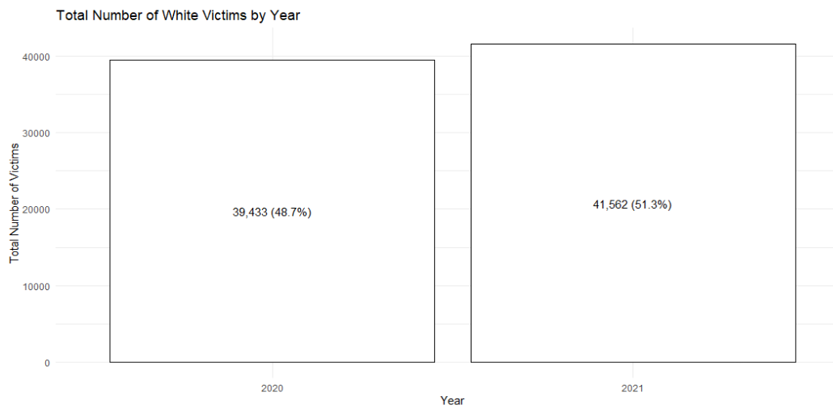
RESULTS
COMPARISON BETWEEN VICTIMIZATION RATES OF ASIAN & WHITE AMERICANS FROM 2020-2021: YEARLY
ASIAN
WHITE

Slide 10
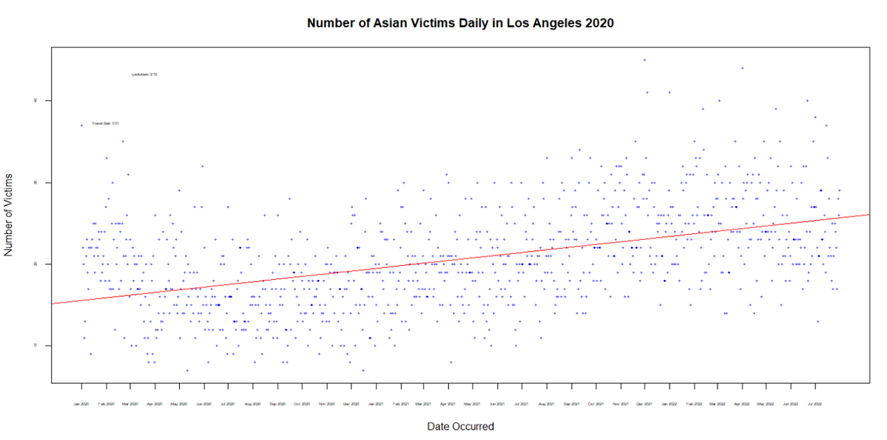
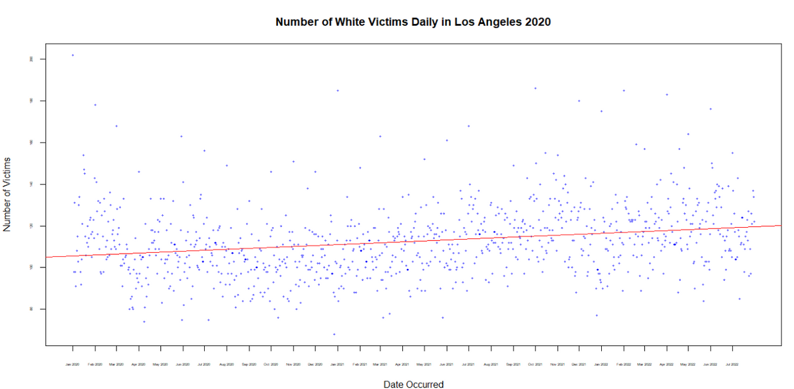
RESULTS
COMPARISON BETWEEN VICTIMIZATION RATES OF ASIAN & WHITE AMERICANS FROM 2020-2021
ASIAN
WHITE

Slide 11
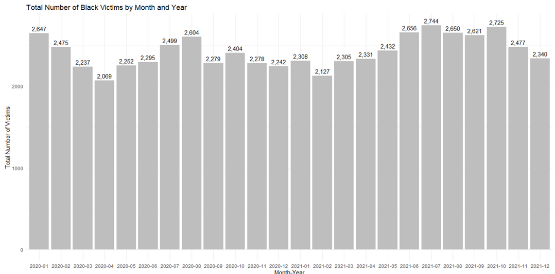
RESULTS
COMPARISON BETWEEN VICTIMIZATION RATES OF BLACK & WHITE AMERICANS FROM 2020-2021: MONTHLY
BLACK
WHITE

Slide 12
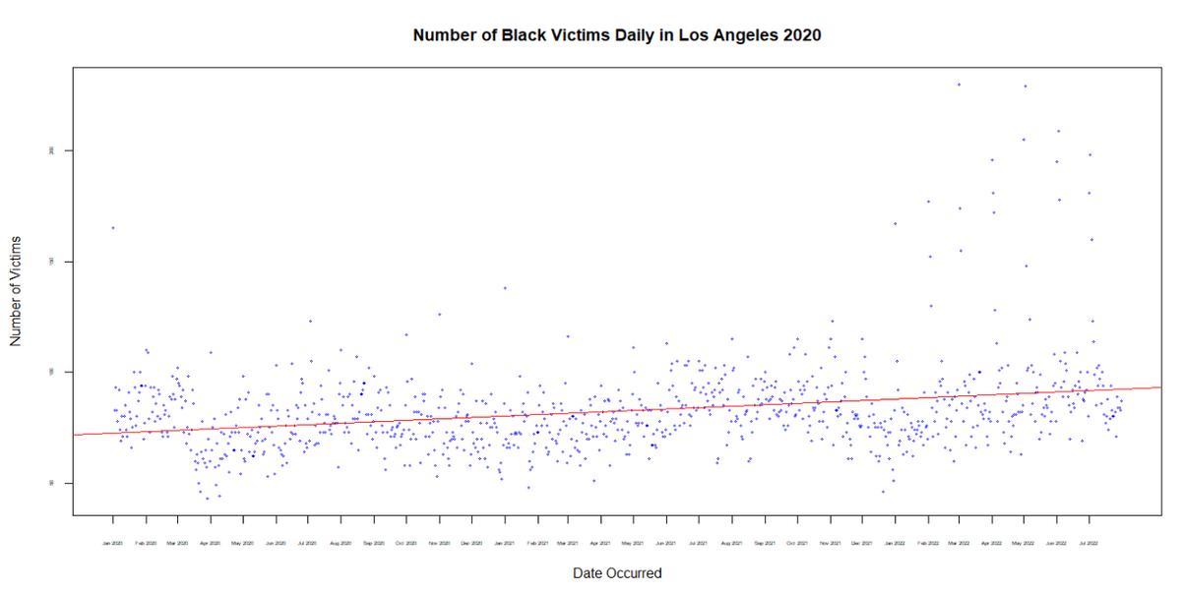
RESULTS
COMPARISON BETWEEN VICTIMIZATION RATES OF BLACK & WHITE AMERICANS FROM 2020-2021
BLACK
WHITE

Slide 13
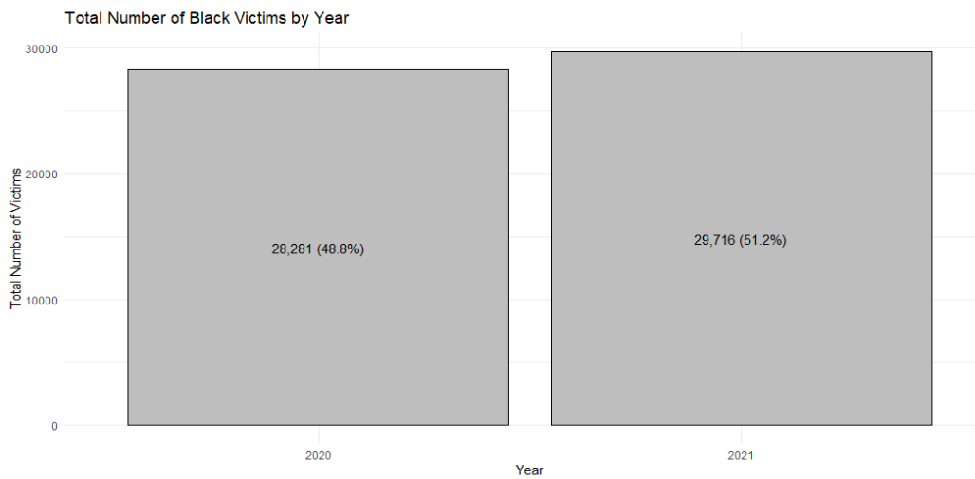
RESULTS
COMPARISON BETWEEN VICTIMIZATION RATES OF BLACK & WHITE AMERICANS FROM 2020-2021: YEARLY
BLACK
WHITE

Slide 14
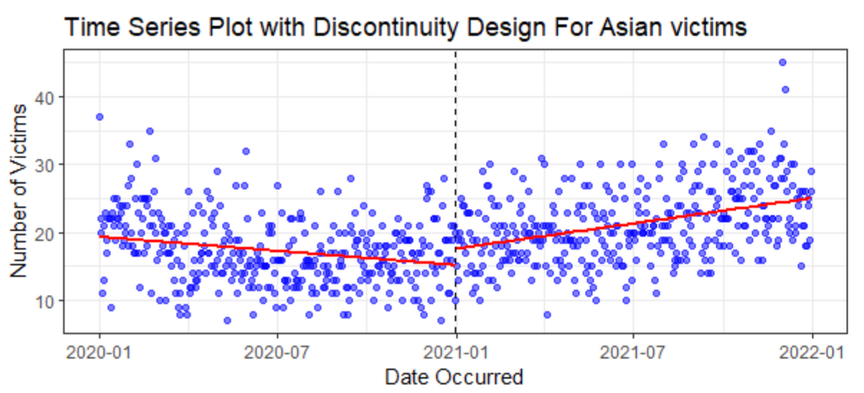
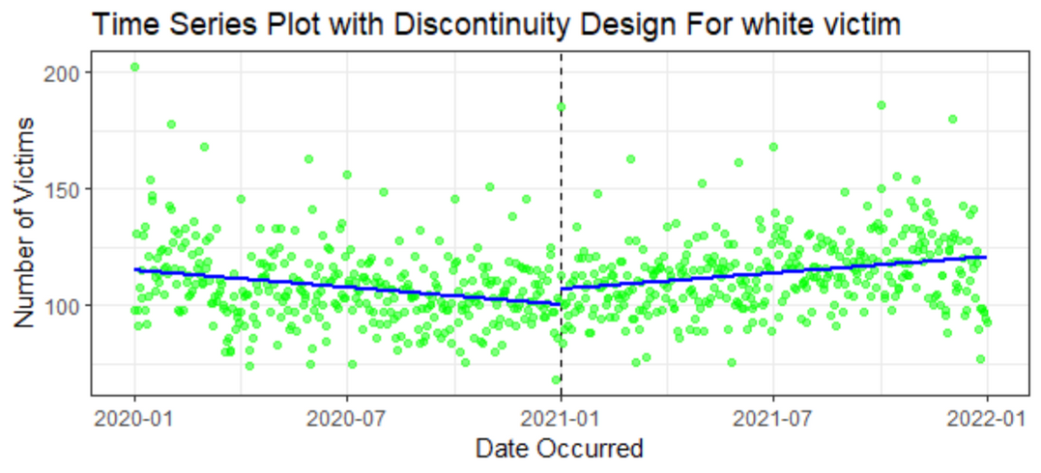
RESULTS
TREND COMPARISON OF DAILY VICTIMIZATION RATES OF ASIAN & WHITE AMERICANS IN LOS ANGELES 2020-2021
TIME SERIES PLOT WITH DISCONTINUITY DESIGN FOR ASIAN VICTIMS
TIME SERIES PLOT WITH DISCONTINUITY DESIGN FOR WHITE VICTIMS
ASIAN
WHITE

Slide 15
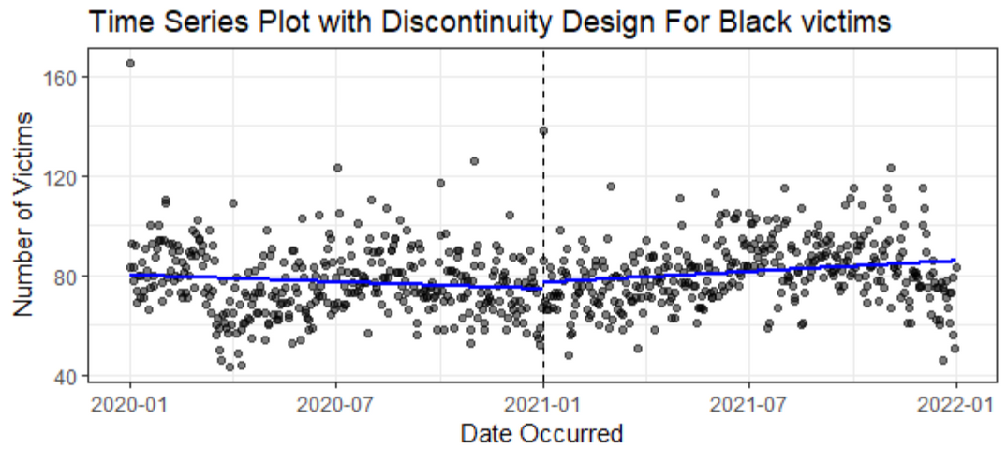
RESULTS
TREND COMPARISON OF DAILY VICTIMIZATION RATES OF BLACK & WHITE AMERICANS IN LOS ANGELES 2020-2021
TIME SERIES PLOT WITH DISCONTINUITY DESIGN FOR BLACK VICTIMS
TIME SERIES PLOT WITH DISCONTINUITY DESIGN FOR WHITE VICTIMS
BLACK
WHITE

Slide 16
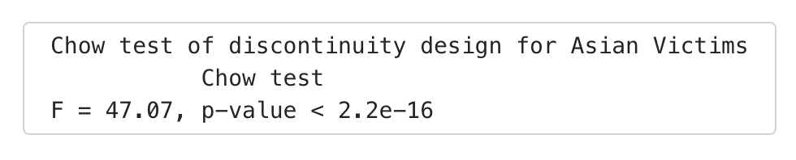
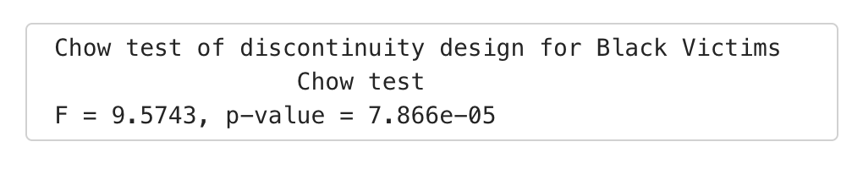
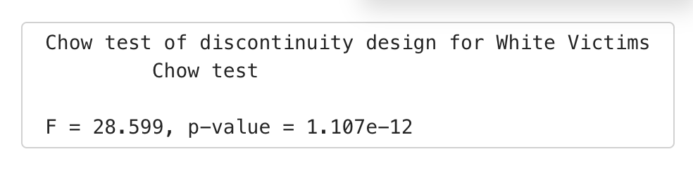
RESULTS
CHOW TEST
ASIAN
BLACK
WHITE

Slide 17

CONCLUSION
The hate crimes against Asian Americans during the COVID-19 pandemic, alongside the pivotal events of 2020, including the 2020 U.S. Presidential Election and the Black Lives Matter (BLM) protests, have each left a distinctive mark on the American societal landscape.
According to the data visualization analysis, from 2020 to 2022 there was a slight discontinuity in hate crimes against Asian Americans in the city of Los Angeles before and after a certain time point. Still, the regression line of black hate crime almost remained consistent. However, the Chow test rest shows both groups suffered a significant change in victim rate, We fail to reject both hypothesis#1, and hypothesis#2

Slide 18

SHINY APP DEMO

Slide 19
WORKS CITED
SMITH, D. (2020). THE BLACK LIVES MATTER MOVEMENT AND ITS IMPACT ON POLICING AND POLICY
CHANGES. JOURNAL OF PUBLIC POLICY AND SOCIAL CHANGE, 25(1), 12-30.

